Slide 1

DriverPass System Analysis
By: Latrelle Dickey
Notes:
[No speaker notes required for this slide.]

Slide 2

System Requirements
Functional
Driving packages
Program sync to DMV policies
Nonfunctional
Adaptability
Up to date patches on the program
Notes:
The two functional requirement that will meet Driver pass needs it the driving packages and the sync to the DMV webpage. The system needs to sync to the DMV page to ensure customers are reading the most updated policies and testing/study materials from the DMV. For the driving packages, the customer can select which package they would like to purchase. The packages will be controlled and modified by DriverPass.
The two nonfunctional requirements that will meet DriverPass needs are its need to stay updated with patches and its adaptability to function on different platforms like mobile devices, tablets, and operating systems. The system needs to stay up to date on its patches for bugs and breaches.

Slide 3
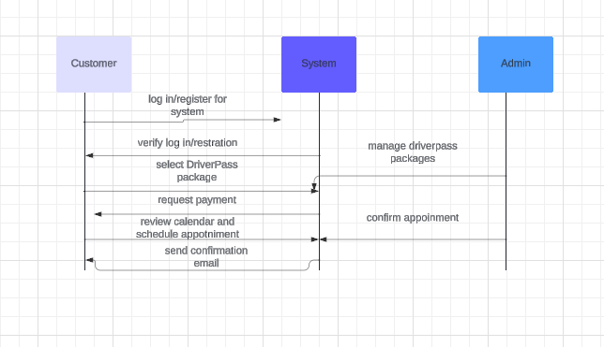
Use Case Diagram
[Insert your use case diagram here.]
Notes:
The diagram shown is the customer interaction with the program. During the log in/ registration phase the system and customer interaction. After the customer is logged in they are brought to the the driver package to purchase and schedule an appointment. At this point, the customer, system, and admin are interacting with each other. The admin is modifying the driver package and calendar for drive time. The system is the middleman it shows the available packages, appointment time, and confirmation of purchase and appointment.

Slide 4
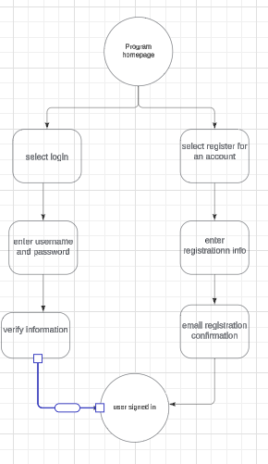
Activity Diagram
[Insert one of your activity diagrams here.]
Notes:
The diagram shown is the customer on the home webpage. They are given the option to register for an account or log into their existing account. If the customer is logging in, they will input their username and password. Then the system will verify their information. If it’s valid they will be logged into the system. If the customer registers for an account, they will be prompted to input their info and create a username and password. After that they will be sent a registration confirmation email then they will be signed into the portal.

Slide 5
Security
Accounts created for the admin team and security team
2-step authentication
Notes:
Accounts should be created with restrictions for each member of the team to prevent certain employees without the need to know from accessing certain things within the program. 2-step authentication should be applied to all the accounts created or a limit should be put in place to eliminate brute force.

Slide 6
System Limitations
Budget
Staffing
Access to sync to DMV webpage
Notes:
One of the limitations of the system is the budget, we are not too sure what the client would like to pay for. Staffing is another limitation due to not knowing the type of skills the client team may have. Lastly, the access to sync to the DMV webpage is a limitation due to not knowing the type of security features the DMV webpage may have may prevent the sync.

